Slide 1


CMR TECHNICAL CAMPUS
UGC AUTONOMOUS
Accredited by NBA & NAAC with A Grade
Approved by AICTE, New Delhi and Affiliated to JNTU, Hyderabad
Department of Computer Science and Engineering
Review-ll
Real Time Research Project
On
Detecting Web Attacks Using End to End Deep Learning
Under the Guidence of
Mrs. Ch.Shital
(Assistant Professor)
Presented By:
P Sri Nikitha
B Tejasree
P Pranavi

Slide 2
Introduction :
Web applications have grown rapidly in recent years.
This growth has led to an increase in cyber attacks such as SQL injection, cross-site scripting, and denial-of-service attacks.
Security has become a major concern in today’s digital world.
Traditional security systems include rule-based and signature-based methods.
These systems depend on predefined patterns and manual feature extraction.
This dependency limits their ability to detect new and evolving threats effectively.
The project proposes an end-to-end deep learning approach to address these challenges.
The approach automatically learns patterns from web traffic data.
It accurately classifies data as normal or malicious.
This improves detection accuracy, reduces human effort, and enhances overall web application security.

Slide 3
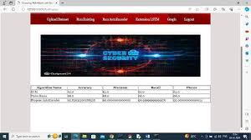
Abstract :
The project titled “Detecting Web Attacks with End-to-End Deep Learning” aims to enhance cybersecurity by developing an intelligent system capable of identifying and classifying web-based attacks.
Traditional security methods such as rule-based and signature-based systems often fail to detect evolving threats, making automated solutions necessary.
This project uses deep learning
models such as MLP , Autoencoder,LSTM to
analyze web traffic data and cyber attacks.
It identifies anomalies , classifies threats
Accurately , and adapts to new attack patterns
in real time .
By eliminating manual features engineering ,
the system improves accuracy.

Slide 4
Existing Systems :
Rule-based and signature-based intrusion detection systems (IDS)
Uses traditional machine learning algorithms like SVM and Naïve Bayes
Requires manual feature engineering
Detects only known attack patterns

Slide 5
Disadvantages:
Large Data Requirement
Lack of Interpretability (Black Box Nature)
High Computational Cost
Slow Training and Deployment
Overfitting Risk
Difficulty in Handling New (Zero-Day) Attacks
7. Data Imbalance Problem

Slide 6
Proposed System :
End-to-End Deep Learning based system
Uses Autoencoder and LSTM models
Learns directly from raw web traffic data
Supports real-time and adaptive attack detection

Slide 7
Problem Statement :
Develop an End-to-End Deep Learning system for attack detection
Process raw web traffic directly (no manual feature extraction)
Use Autoencoder for anomaly (unknown attack) detection
Use LSTM for sequential and time-based attack patterns
Enable real-time monitoring and detection
Reduce false positives and false negatives
Support continuous learning and adaptability
Provide accurate, scalable, and automated security solution

Slide 8
Advantages :
High detection accuracy
Real-time monitoring and detection
Automatic feature learning (no manual work)
Adapts to new and evolving threats
Reduced false positives and negatives

Slide 9
Hardware Requirements :
Processor: i3 or above
RAM: 4 GB
Hard Disk: 40 GB
Software Requirements
Operating System: Windows 8 or above
Programming Language: Python
Framework: Django

Slide 10
Novelty of the Project
End-to-End learning without manual feature engineering
Combination of traditional ML and deep learning models
Real-time adaptive cybersecurity system
Handles multi-dimensional web traffic data

Slide 11
Modules:
Data Collection Module
Data Preprocessing Module
Feature Representation Module (End-to-End Input)
Model Building Module
Training Module
Evaluation Module
Attack Detection Module
Alert & Response Module

Slide 12
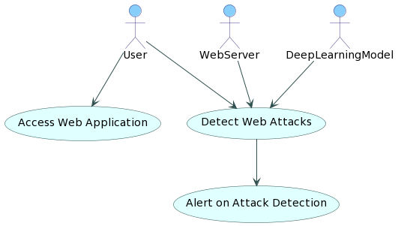
Architecture Modules :
Data Collection Module
Preprocessing Module
Feature Extraction Module
Detection/Classification
Module
Alert & Response Module
User Interface Module

Slide 13
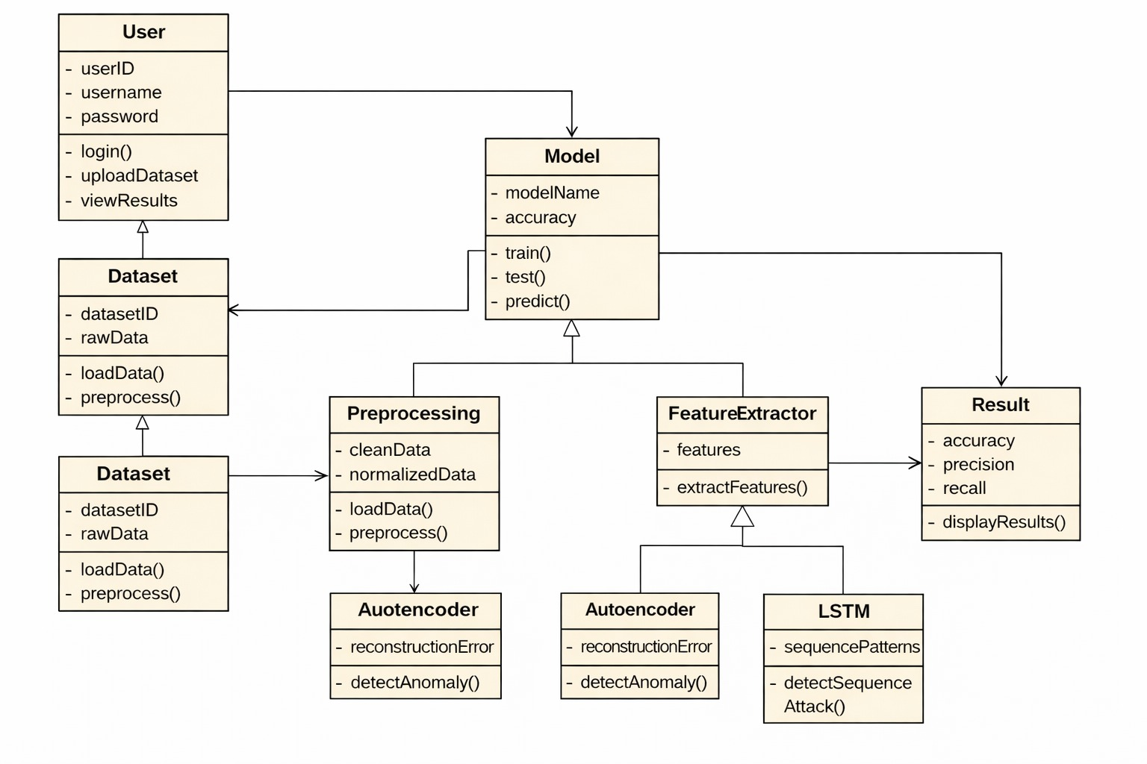
UML Diagram :

Slide 14
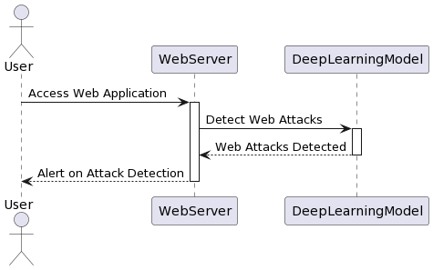
sequence diagram

Slide 15
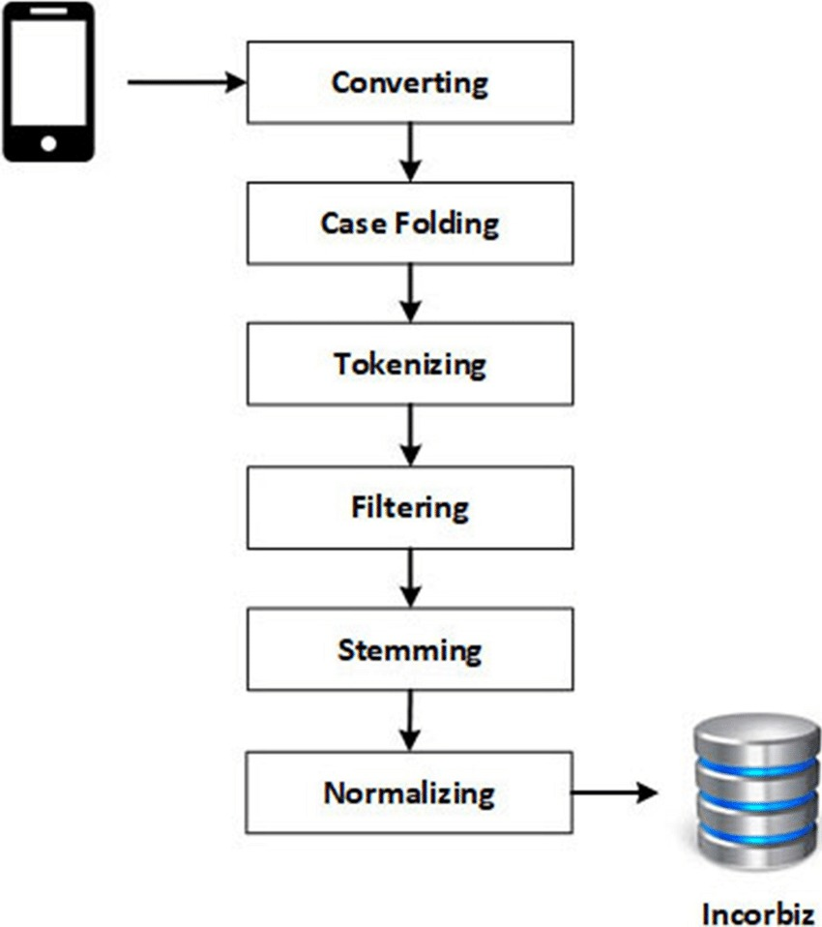
Activity Diagram

Slide 16
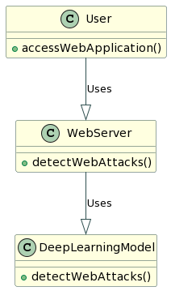
Class Diagram

Slide 17
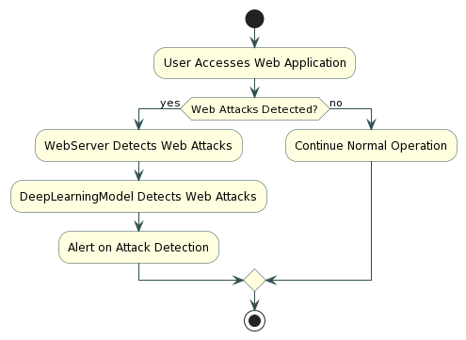
Collaboration Diagram

Slide 18
Source code:
main = tkinter.Tk()
main.title("A Deep Learning-Based Approach for Inappropriate Content Detection and Classification of YouTube Videos") main.geometry("1200x1200")
content_model = load_model("model/content_model.h5")
global X_train, X_test, y_train, y_test global bilstm_model, cnn_model global X, Y, X1, Y1 accuracy = [] precision = [] recall = [] fscore = []
def uploadDataset():
global filename, dataset, textdata, labels text.delete('1.0', END)
filename = filedialog.askdirectory(initialdir=".") text.insert(END,str(filename)+" Dataset Loaded\n\n") pathlabel.config(text=str(filename)+" Dataset Loaded") img =cv2.imread("Dataset/InappropriateContent/316.jpg") img = cv2.resize(img, (500, 400)) cv2.imshow("Loaded Sample Image", img) cv2.waitKey(0)
def preprocessDataset(): text.delete('1.0', END) global X, Y, X1, Y1 if os.path.exists("model/X.txt.npy"):
X = np.load('model/X.txt.npy') Y = np.load('model/Y.txt.npy')
X1 = np.load('model/X1.txt.npy')
Y1 = np.load('model/Y1.txt.npy') else:
X = [] Y = [] for root, dirs, directory in os.walk('Dataset'):
for j in range(len(directory)): name = os.path.basename(root) if 'Thumbs.db' not in directory[j]: img = cv2.imread(root+"/"+directory[j]) img = cv2.resize(img, (32, 32)) label = 0 if name == 'InappropriateContent':
label = 1

Slide 19
X.append(img) Y.append(label)
print(name+" "+directory[j]+" "+str(label))
X = np.asarray(X) Y = np.asarray(Y) np.save('model/X1.txt',X) np.save('model/Y1.txt',Y)
X = X.astype('float32') X = X/255 indices = np.arange(X.shape[0]) np.random.shuffle(indices)
= X[indices]
= Y[indices]
unique, count = np.unique(Y1, return_counts = True) Y = to_categorical(Y)
text.insert(END,"Total images found in dataset : "+str(X1.shape[0])+"\n\n") text.insert(END,"Labels in dataset : Safe & Inappropriate Content") text.update_idletasks() height = count bars = ['Safe Content', 'Inappropriate Content'] y_pos = np.arange(len(bars)) plt.bar(y_pos, height) plt.xticks(y_pos, bars)
plt.title("Safe & Inappropriate Content found in dataset") plt.xlabel("Youtube Content Type") plt.ylabel("Count") plt.show()
def calculateMetrics(algorithm, predict, target): acc = accuracy_score(target,predict)*100
p = precision_score(target,predict,average='macro') * 100 r = recall_score(target,predict,average='macro') * 100 f = f1_score(target,predict,average='macro') * 100 text.insert(END,algorithm+" Precision : "+str(p)+"\n") text.insert(END,algorithm+" Recall : "+str(r)+"\n") text.insert(END,algorithm+" F1-Score : "+str(f)+"\n") text.insert(END,algorithm+" Accuracy : "+str(acc)+"\n\n") text.update_idletasks() precision.append(p) accuracy.append(acc) recall.append(r) fscore.append(f)
LABELS = ['Safe Content', 'Inappropriate Content'] conf_matrix = confusion_matrix(target, predict) plt.figure(figsize =(6, 6))
ax = sns.heatmap(conf_matrix, xticklabels = LABELS, yticklabels = LABELS,
annot = True, cmap="viridis" ,fmt ="g"); ax.set_ylim([0,2])
plt.title(algorithm+" Confusion matrix") plt.ylabel('True class') plt.xlabel('Predicted class') plt.show()

Slide 20
def runExistingSVM(): global vectorizer, X, Y
Y = np.argmax(Y, axis=1)
X_train, X_test, y_train, y_test = train_test_split(X, Y, test_size=0.2) global accuracy, precision, recall, fscore svm_cls = svm.SVC(C=2.0, kernel="sigmoid") svm_cls.fit(X_train,y_train) predict = svm_cls.predict(X_test)
calculateMetrics("EfficientNet-SVM", predict, y_test)
def rf():
global vectorizer, X, Y
# Check if Y is 2D (one-hot encoded) and transform it to 1D if len(Y.shape) > 1 and Y.shape[1] > 1:
Y = np.argmax(Y, axis=1) # Convert one-hot encoded labels to class indices
# Split data into training and testing sets
X_train, X_test, y_train, y_test = train_test_split(X, Y, test_size=0.2)
# Initialize RandomForestClassifier and train the model global accuracy, precision, recall, fscore
rf_model = RandomForestClassifier(n_estimators=100, random_state=42) rf_model.fit(X_train, y_train)
# Make predictions and evaluate metrics predict = rf_model.predict(X_test)
calculateMetrics("EfficientNet-RFC", predict, y_test)

Slide 21
def runProposeAlgorithms(): text.delete('1.0', END)
global bilstm_model, cnn_model, X, Y global accuracy, precision, recall, fscore accuracy.clear() precision.clear() recall.clear() fscore.clear()
X_train, X_test, y_train, y_test = train_test_split(X, Y, test_size=0.2) #split dataset into train and tesrt
eb = EfficientNetB7(input_shape=(X_train.shape[1], X_train.shape[2],
X_train.shape[3]), include_top=False, weights=None) eb.trainable = False cnn_model = Sequential() cnn_model.add(eb)
cnn_model.add(Convolution2D(32, (1, 1), input_shape = (X_train.shape[1],
X_train.shape[2], X_train.shape[3]), activation = 'relu')) cnn_model.add(MaxPooling2D(pool_size = (1, 1))) cnn_model.add(Convolution2D(32, (1, 1), activation = 'relu')) cnn_model.add(MaxPooling2D(pool_size = (1, 1))) cnn_model.add(Flatten())
cnn_model.add(Dense(units = 256, activation = 'relu'))
cnn_model.add(Dense(units = y_train.shape[1], activation = 'softmax')) cnn_model.compile(optimizer = 'adam', loss = 'categorical_crossentropy', metrics
= ['accuracy']) if os.path.exists("model/model_weights.hdf5") == False:
model_check_poin = ModelCheckpoint(filepath='model/model_weights.hdf5',
verbose = 1,
save_best_only = True) hist = cnn_model.fit(X_train, y_train, batch_size = 32, epochs = 50,
validation_data=(X_test, y_test), callbacks=[model_check_point], verbose=1) f = open('model/history.pckl', 'wb') pickle.dump(hist.history, f)
f.close()
else:
cnn_model = load_model("model/model_weights.hdf5")
cnn_model = Model(cnn_model.inputs, cnn_model.layers[-2].output)#creating
cnn model

Slide 22
cnn_features = cnn_model.predict(X) #extracting cnn features from test data X = cnn_features print(X.shape)
cnn_features = np.reshape(cnn_features, (cnn_features.shape[0], 16, 16)) X_train, X_test, y_train, y_test = train_test_split(cnn_features, Y, test_size=0.2) bilstm_model = Sequential() #defining deep learning sequential object
#adding LSTM bidirectional layer with 32 filters to filter given input X train data to select relevant features
bilstm_model.add(Bidirectional(LSTM(32, input_shape=(X_train.shape[1],
X_train.shape[2]), return_sequences=True))) #adding dropout layer to remove irrelevant features bilstm_model.add(Dropout(0.2)) #adding another layer
bilstm_model.add(Bidirectional(LSTM(32))) bilstm_model.add(Dropout(0.2)) #defining output layer for prediction
bilstm_model.add(Dense(y_train.shape[1], activation='softmax'))
#compile GRU model
bilstm_model.compile(loss='categorical_crossentropy', optimizer='adam',
metrics=['accuracy'])
#start training model on train data and perform validation on test data if os.path.exists("model/bilstm_weights.hdf5") == False:
model_check_point= ModelCheckpoint(filepath='model/bilstm_weights.hdf5', verbose = 1, save_best_only = True) hist = bilstm_model.fit(X_train, y_train, batch_size = 16, epochs = 20,
validation_data=(X_test, y_test), callbacks=[model_check_point], verbose=1) else:
bilstm_model = load_model("model/bilstm_weights.hdf5")
predict = bilstm_model.predict(X_test) predict = np.argmax(predict, axis=1) target = np.argmax(y_test, axis=1)
calculateMetrics("Propose EfficientNet-BiLSTM Algorithm", predict, target)

Slide 23
def meanLoss(image1, image2): difference = image1 - image2 a,b,c,d,e = difference.shape n_samples = a*b*c*d*e sq_difference = difference**2 Sum = sq_difference.sum() distance = np.sqrt(Sum) mean_distance = distance/n_samples return mean_distance
def predict():
global content_model text.delete('1.0', END) filename = filedialog.askopenfilename(initialdir="testVideos") cap = cv2.VideoCapture(filename) print(cap.isOpened()) while cap.isOpened(): imagedump=[] ret,frame=cap.read() for i in range(10):
ret,frame=cap.read() if frame is not None:
image = imutils.resize(frame,width=700,height=600)
frame=cv2.resize(frame, (227,227), interpolation = cv2.INTER_AREA) gray=0.2989*frame[:,:,0]+0.5870*frame[:,:,1]+0.1140*frame[:,:,2] gray=(gray-gray.mean())/gray.std() gray=np.clip(gray,0,1) imagedump.append(gray)
imagedump=np.array(imagedump) imagedump.resize(227,227,10)
imagedump=np.expand_dims(imagedump,axis=0) imagedump=np.expand_dims(imagedump,axis=4) output=content_model.predict(imagedump) loss=meanLoss(imagedump,output) if frame is not None:
if frame.any()==None:
print("none")
else:
break
if cv2.waitKey(10) & 0xFF==ord('q'):
break

Slide 24
print(str(frame)+" "+str(loss)) if loss>0.00068:
print('Inappropriate Content') cv2.putText(image,"Inappropriate
Content",(100,80),cv2.FONT_HERSHEY_SIMPLEX,1.5,(0,0,255),4) else:
cv2.putText(image,"Safe
Content",(100,80),cv2.FONT_HERSHEY_SIMPLEX,1.5,(0,255,255),4) cv2.imshow("video",image)
cap.release() cv2.destroyAllWindows()
def graph():
df=pd.DataFrame([['EfficientNet-
BiLSTM','Precision',precision[0]],['EfficientNet- BiLSTM','Recall',recall[0]],['EfficientNet-BiLSTM','F1
Score',fscore[0]],['EfficientNet-BiLSTM','Accuracy',accuracy[0]],
['EfficientNet-SVM','Precision',precision[1]],['EfficientNet-
SVM','Recall',recall[1]],['EfficientNet-SVM','F1 Score',fscore[1]],['EfficientNet-
SVM','Accuracy',accuracy[1]],
['EfficientNet-RFC','Precision',precision[2]],['EfficientNet- RFC','Recall',recall[2]],['EfficientNet-RFC','F1-score',fscore[2]],['EfficientNet-
RFC','Accuracy',accuracy[2]]],
columns=['Parameters','Algorithms','Value'])
# Using pivot_table for aggregation
df.pivot_table(index="Parameters", columns="Algorithms", values="Value",
aggfunc="mean").plot(kind='bar')
plt.show()

Slide 25
def close(): main.destroy()
font = ('times', 14, 'bold')
title = Label(main, text='A Deep Learning-Based Approach for Inappropriate Content Detection and Classification of YouTube Videos') title.config(bg='DarkGoldenrod1', fg='black') title.config(font=font) title.config(height=3, width=120) title.place(x=5,y=5)
font1 = ('times', 13, 'bold')
uploadButton = Button(main, text="Upload Youtube Normal & Inappropriate Content Dataset", command=uploadDataset) uploadButton.place(x=50,y=100)
uploadButton.config(font=font1)
pathlabel = Label(main)
pathlabel.config(bg='brown', fg='white') pathlabel.config(font=font1) pathlabel.place(x=560,y=100)
preprocessButton = Button(main, text="Dataset Preprocessing", command=preprocessDataset) preprocessButton.place(x=50,y=150) preprocessButton.config(font=font1)
svmButton = Button(main, text="Generate & Load EfficientNet-SVM Model", command=runExistingSVM) svmButton.place(x=50,y=250) svmButton.config(font=font1)
rfButton = Button(main, text="Generate & Load EfficientNet-RF Model", command=rf) rfButton.place(x=50,y=300) rfButton.config(font=font1)
proposeButton = Button(main, text="Generate & Load Propose DL-BILSTM-GRU Model", command=runProposeAlgorithms) proposeButton.place(x=50,y=200) proposeButton.config(font=font1)
graphButton = Button(main, text="Comparison Graph", command=graph) graphButton.place(x=50,y=350) graphButton.config(font=font1)

Slide 26
predictButton = Button(main, text="Inappropriate Content Prediction from Test
Video", command=predict)
predictButton.place(x=50,y=400) predictButton.config(font=font1)
exitButton = Button(main, text="Exit", command=close) exitButton.place(x=50,y=450) exitButton.config(font=font1)
font1 = ('times', 12, 'bold') text=Text(main,height=25,width=90) scroll=Scrollbar(text)
text.configure(yscrollcommand=scroll.set) text.place(x=500,y=150) text.config(font=font1)
main.config(bg='LightSteelBlue1') main.mainloop()

Slide 27
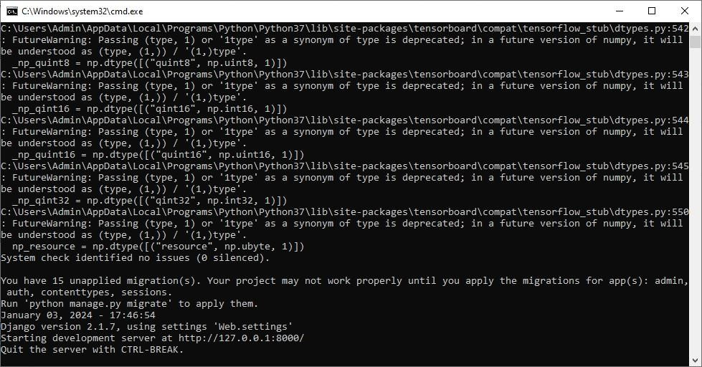
Result :

Slide 28
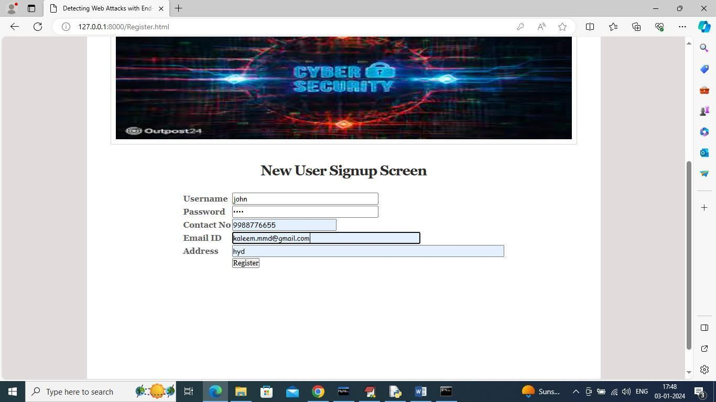
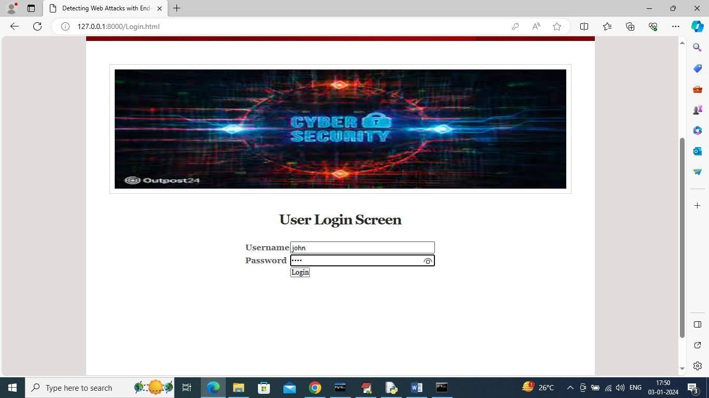

Slide 29
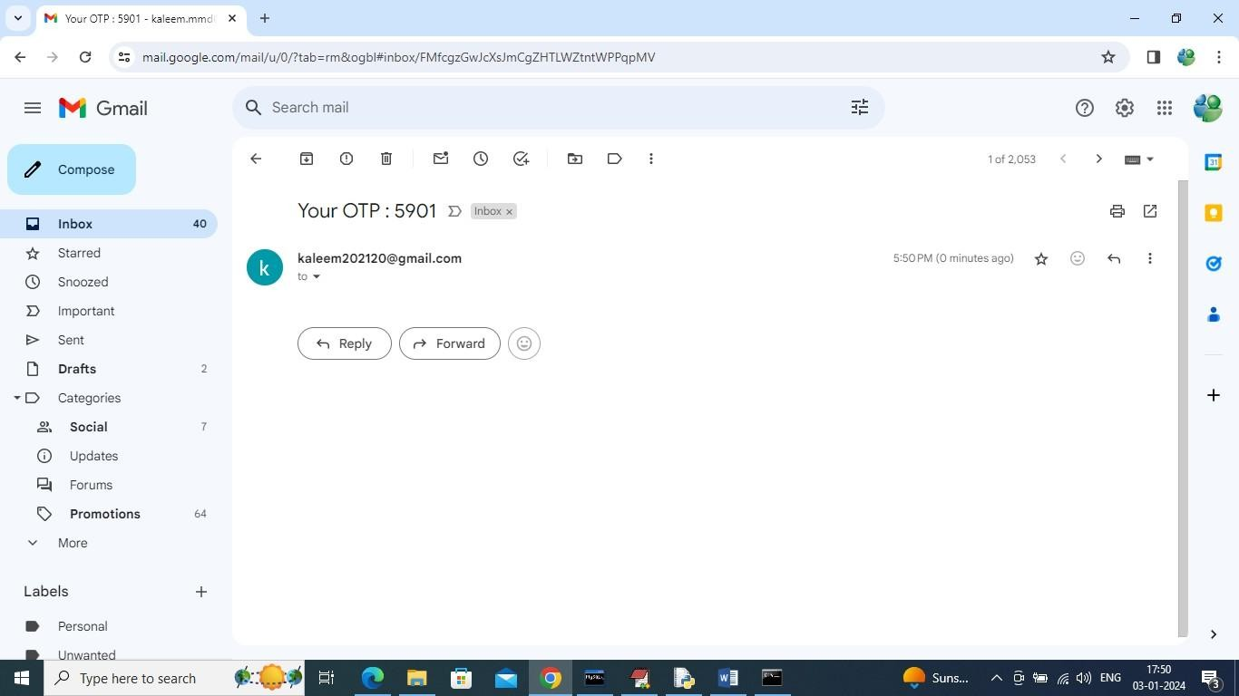
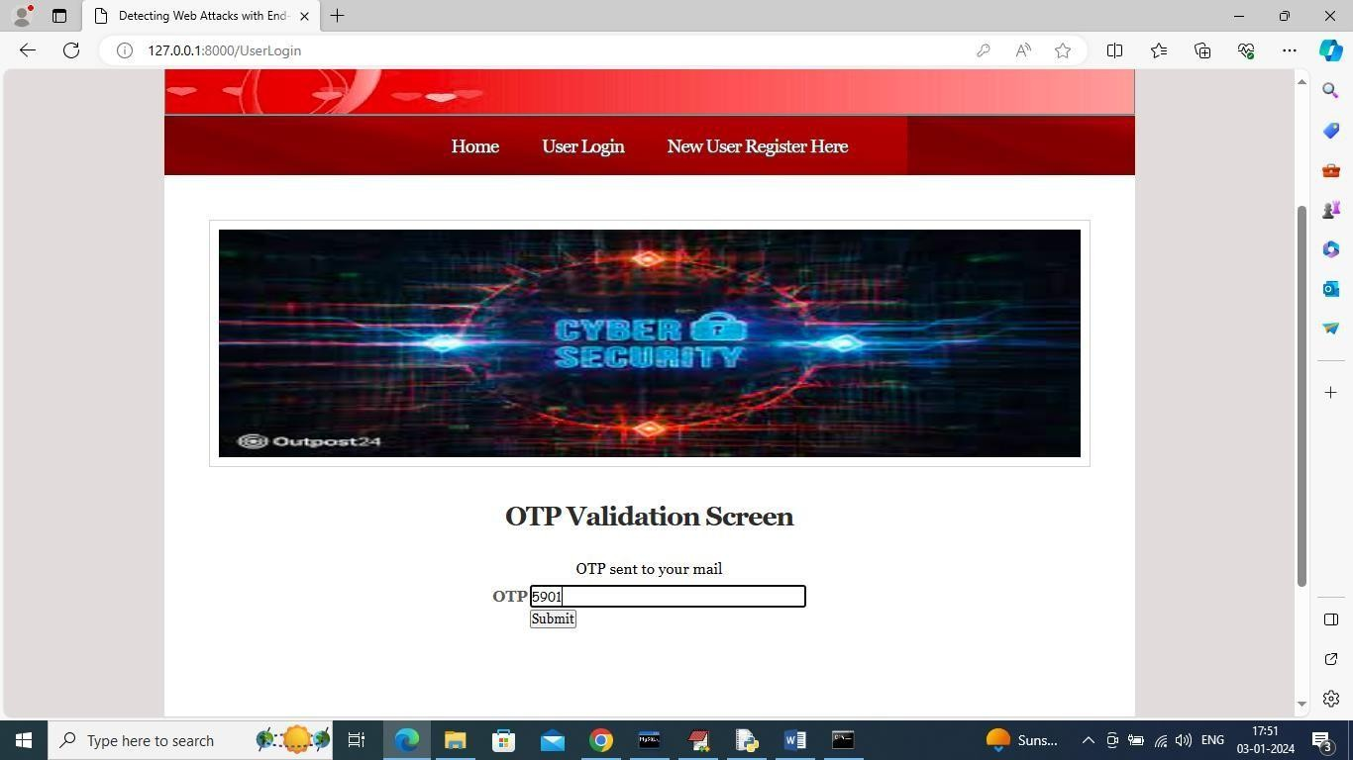

Slide 30
Conclusion
Deep learning improves web security significantly
Detects both known and unknown attacks
Provides scalable and efficient solution
Suitable for modern cybersecurity systems

Slide 31
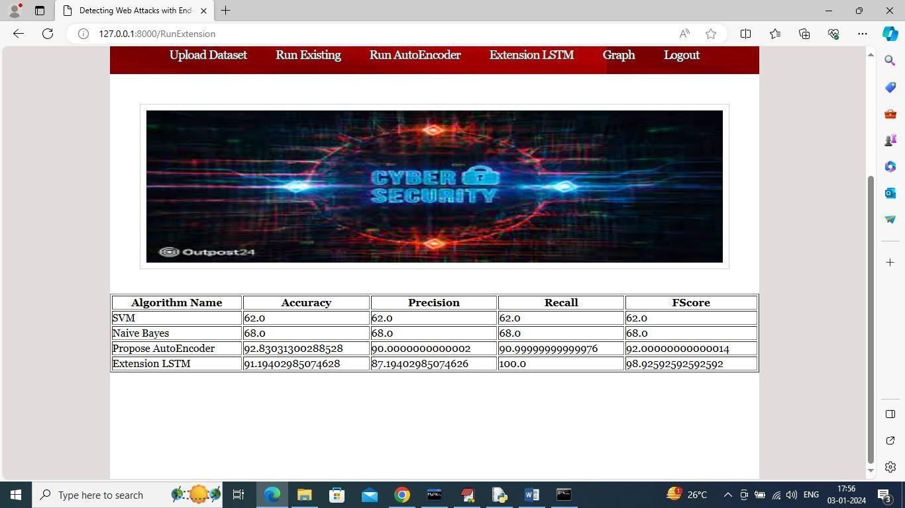
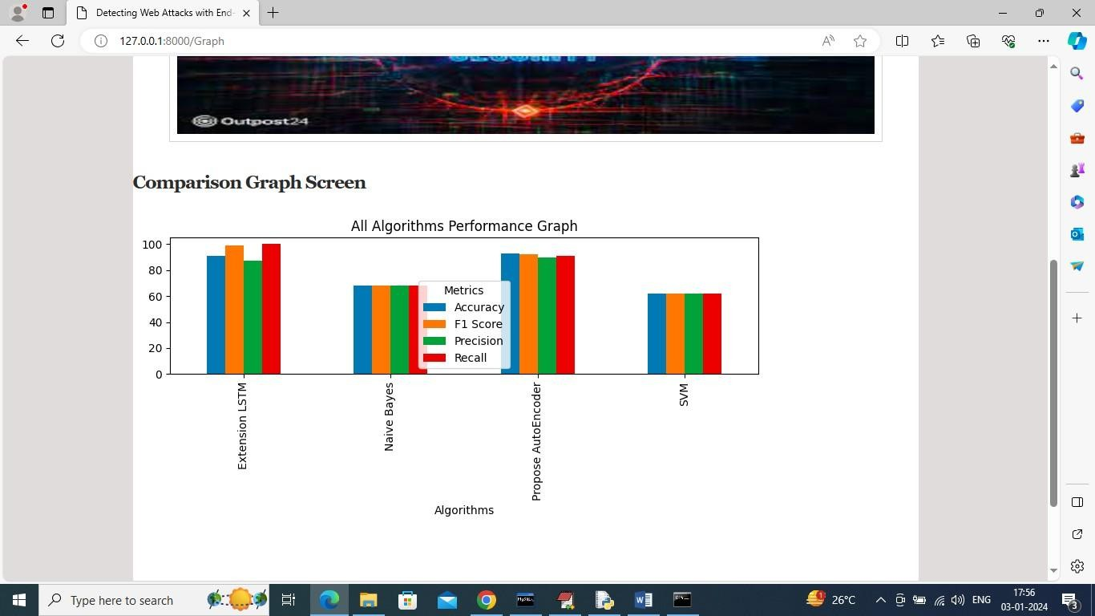

Slide 32
Future Enhancements
Real-time deployment in live environments
Integration with cloud and IDS systems
Use of Explainable AI (XAI)
Detection of advanced and zero-day attacks

Slide 33
References :
Research papers on Deep Learning in Cybersecurity
Studies on Web Attack Detection
IDS and Machine Learning research articles

